Slide 1
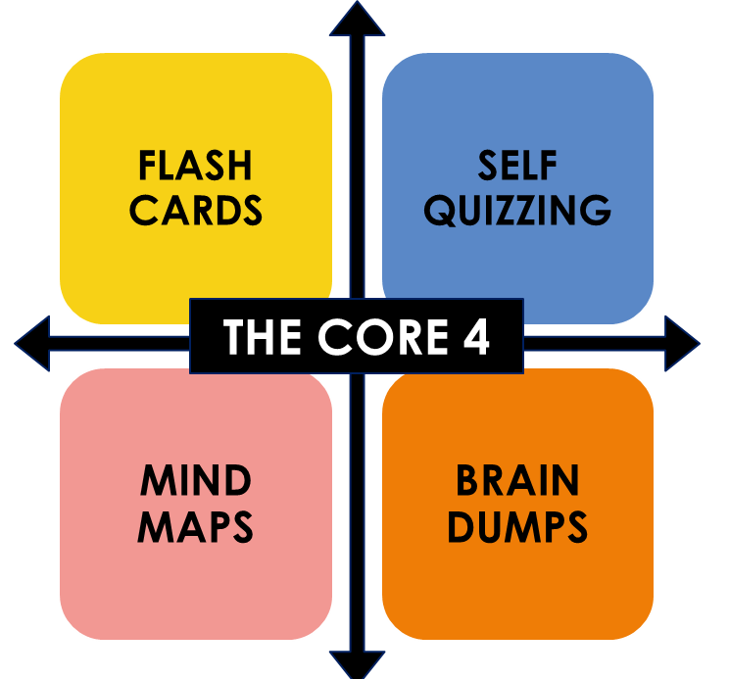
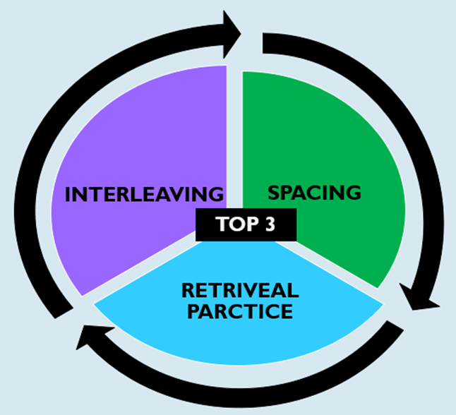
 | Period 1 | Period 2 | Period 3 | Period 4 | Period 5 | Period 6 | Break
Day | 8.50-9.50am | 9.50-11.10am | 11.10-12.10pm | 12.10pm-1.55pm | 1.55-2.55pm | 3.05-4.00pm | 4.00pm-5.00pm | 5.00-6.00pm | 6.00pm-7.00pm | 7.00pm-8.00pm | 9.00pm-9.00pm | 9.00pm-10.00pm
Monday
Tuesday
Wednesday
Thursday
Friday
Saturday
Sunday
TO DO LIST:
Key topics I will be revising this week
School Day
Travel from school or resting etc.
Subjects I need to prioritise this week:
English Language: _____________
English Literature: ____________
Maths: ___________
Double Award Science/Triple Science: _________
MY EXAMS
Option A:__________________ ____ exams
Option B:__________________ ____ exams
Option C:__________________ ____ exams
Option D:__________________ ____ exams

